Slide 1



美安革新概念
購物年金
Evolution of MA
Shopping Annuity

Slide 2



























人生中所有消費
All Spending
Age 0 to now
我們的貢獻=各大品牌的成長
大眾行銷模式與品牌希望與我們劃清界線！為甚麼？因為他們可以控制個別顧客、支配商品價格與發售地點！如今數碼年代消費者已不必受此限制，網上購物可隨時聚集顧客和累積強大的集體購買力。
Our Contribution = Their Growth
The Mass Marketing Paradigm & Brand Establishment wants to keep us separated or apart! WHY? So they can control us individually and dictate price and where we buy ! In a digital age it is no longer necessary.
It allows for aggregation and collective buying power.

Slide 3












傳統現貨巿場 – 以實體商店建立大眾行銷
Traditional Physical Market
Establishment Mass Marketing with Brick & Mortar
顧客Consumer
成本COST
成本COST
成本COST
$
$
$
傳統連鎖店把產品輸送到多個地點，產生高昂運輸費用，佔20-30%；而廣告費，品牌行銷開支佔30%，合共50-60%
A traditional commodity chain moves products through a number of locations. This has a high logistical cost. 20% -30% + Mass Media advertising , Branding, marketing 30% = 50-60%
革新的機會：
即時直接送貨以減低成本
The opportunity for innovation：
Transfer the product once to cut costs

Slide 4


SHOP.COM創造革新經營模式！
shop.com innovates new business model once again!

Slide 5
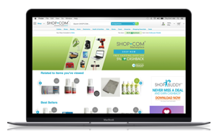


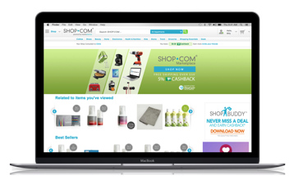

SHOP.COM 與消費者分享 - 先進個人化網站，提供合適建議與商店基本分類
SHOP.COM Shares Profile with consumers - True progressive customization of home page offers & recommendations + Shop essential category offers.
顧客Consumer
網站儲存空間租金
會員年費/服務費
Internet Mall site Space Rent
Annual Membership Fee or Service Fee
超連鎖店主與優惠顧客在SHOP.COM購物可獲得：
給予優惠顧客免費帳戶
以相等或較低價錢購買心儀產品，並享有現金回贈
個人購物顧問(為顧客尋覓所需商品及提供優惠)
選取夥伴並予以支援
透過系統打造購物年金，轉消費為收入，並累積BV/IBV繼而賺取永續收入
為超連鎖店主及購物年金成員追蹤購物訂單及累積點數
UFO’s + Preferred Consumers of SHOP.COM receive:
Free account offer to PC
Pay the same or lower cost for desired items and get 2~33% cash back.
A personal shop consultant (finds deals and what customer wants)
Selective partner for support + assistance
SHOPPING ANNUITY to convert spending into earning through tracking system and accrual of BV/IBV credit to earn residual income
Tracks Purchases & Accrues Volume for Ongoing Income to UFO’s + Shopping Annuity Members
網絡行銷Internet Marketing
一般網站
General shopping site
顧客確認商品Consumer Confirm Item
扣除服務費只付餘款
Deduct Service Charge
Pay the balance
比較一般購物網站
Comparison
Shopping Site
社交網絡行銷Social Marketing
集合眾人的力量，利用消費者的購買力爭取最佳價格、利潤及現金回贈！
Integrating the power of people
Using Consumer Buying Power to get best prices, share of Margin & Cashback!
提供免費資訊Provide Information Without Charge
網上購物平台- 匯聚互聯網力量
Shopping Portal Site
Integrating the power of Internet
於夥伴商店購物Placing an Order at Partner store
$
夥伴商店付出佣金
美安轉化佣金為現金回贈及BV以獎勵超連鎖店主
Partner Pay Commission
MA converts to Cash Back & IBV to credit UFO
顧客可享現金回贈
Favored customer Cashback

Slide 6




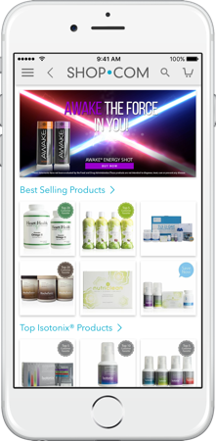
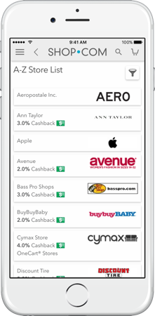
4項致勝協同力量練成經濟煉金術！
Four Winning Synergies Economic Alchemy!
社交網絡行銷
Social
Marketing
超連鎖事業UnFranchise
整合產品Product Integration
優惠顧客
Preferred Customer
超連鎖店主
UnFranchise Owner
美安香港網絡行銷
Market Hong Kong
Internet Marketing
夥伴商店Partner Supplier
賺錢不花成本+現金回贈+購物年金
No cost for making money + Cash Back + SA
購物年金+網上購物=轉消費為收入
Shopping Annuity + Social Shopping = converting our spending into earning!
透過HK.SHOP.COM及超連鎖網站減低成本提高利潤Reduce cost and raise profits via Shop.com + UnFranchise website
獲得更多銷售與會員資料
More sales and membership data

Slide 7



轉消費為收入
推薦追蹤系統
美安香港可以追蹤得知你在美安品牌商店及夥伴商店的所有消費資訊。Market Hong Kong can track and capture all your purchases from our stores, brands and merchants.
你本人購物，或你直接或間接推薦他人購物，你都可以得到代表商品價值單位的BV和IBV點數。
When you or anyone you lead to directly or indirectly, makes a purchase you get credit in the form of a social currency called BV and IBV.
點數可以累積，在達到特定標準時，你就能透過管理業績紅利計畫賺取永續收入。
That currency accumulates and when it reaches certain thresholds, you earn a residual income through the MPCP.
個人護理產品與服務
Personal Care Product & Service
雜項
Miscellaneous
個人護理產品及服務
Personal Care Product & Service
個人護理
Personal Care Product & Service
雜項
Miscellaneous
雜項
Miscellaneous
娛樂
Entertainment
閱讀
Reading
娛樂
Entertainment
閱讀
Reading
娛樂
Entertainment
閱讀
Reading
健康護理
Healthcare
食物
Food
健康護理
Healthcare
食物
Food
健康護理
Healthcare
食物
Food
does it for you
交通
Transportation
房屋
Housing
交通
Transportation
房屋
Housing
交通
Transportation
服裝與服務
Apparel & Service
房屋
Housing
其他服務
Apparel & Service
其他服務
Apparel & Service

Slide 8

推薦追蹤系統讓我們可以善用匯集一體的強大購買力︰Because of the Referral Tracking System, we can leverage our collective buying power to:
  轉利潤為永續收入Convert margins into an ongoing income
  調低價格Force prices down
  賺取更高利潤，並增加BV和IBV，從而增加你的永續收入Get better margins and give increased BV and IBV, thereby, increasing YOUR RESIDUAL INCOME
實踐劃時代概念
It’s an Idea
擁有人力、數字的力量，推薦追蹤系統，管理業績紅利計劃、SHOP.COM優勢......這劃時代概念已經來臨，而且勢不可擋。
With people power, the power of numbers, The Referral Tracking system, the MPCP, the SHOP.COM advantage… it’s time has come and it can’t be stopped.
who’s time has come
Notes:
TRAINERS NOTES:
With technology today, we have the power to leverage our collective buying power!
We don’t need to solely have a consumer: retailer relationship anymore because we can recycle our money by converting the margins earned from shopping through our SHOP.COM website into an ongoing income.
Due to the massive numbers of UFOs and customers shopping through SHOP.COM, we have the power to force prices down and increase the margins that we get from those sales. That allows us to increase BV and IBV which increases your residual income and lessens the time it takes to achieve it.

Slide 9


夥伴商店分享
Partner Store testimonial
IBV: 5%
Cashback:5%
IBV: 5%
Cashback:2%

Slide 10

夥伴商店分享
Partner Store testimonial
IBV: 5%
Cashback:2%

Slide 11







最新加盟夥伴商店
New Partner Stores

Slide 12


